Slide 1
Expense Tracker
A Simple Web-Based Financial Tracker

Slide 2
Introduction
The Expense Tracker is a web application that helps users manage their finances.
Users can set an initial balance, track income and expenses, and view transaction history.

Slide 3
Features
Set and update balance
Track income and expenses
Maintain transaction history
User-friendly interface

Slide 4
User Interface
Video background for aesthetic appeal
Balance section displaying total, income, and expenses
Form for adding transactions
List displaying transaction history

Slide 5
Functionality
Users input an initial balance
Transactions are categorized as income or expense
The system updates and displays the balance dynamically

Slide 6
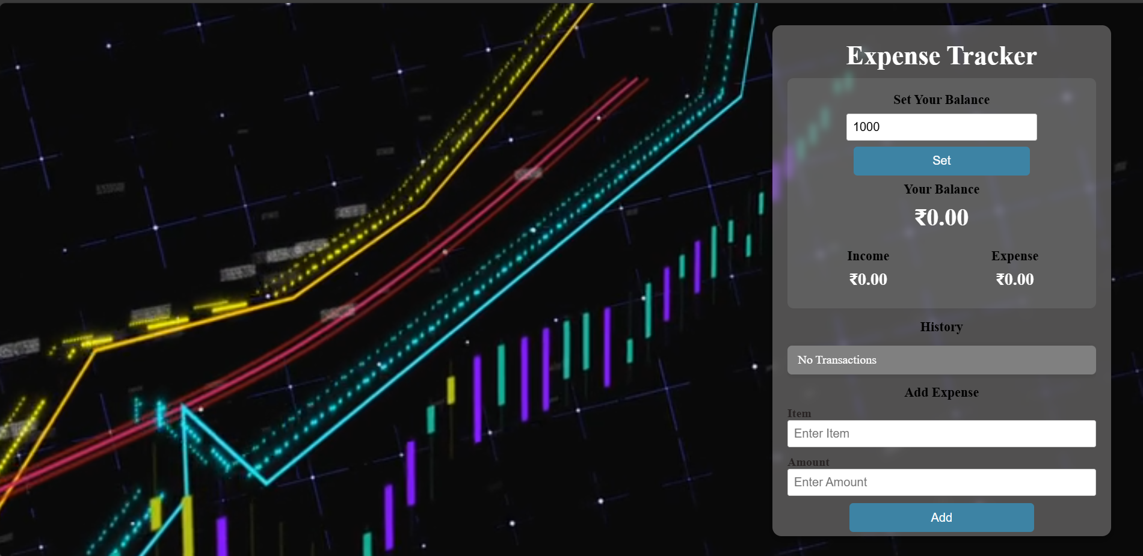


Slide 7
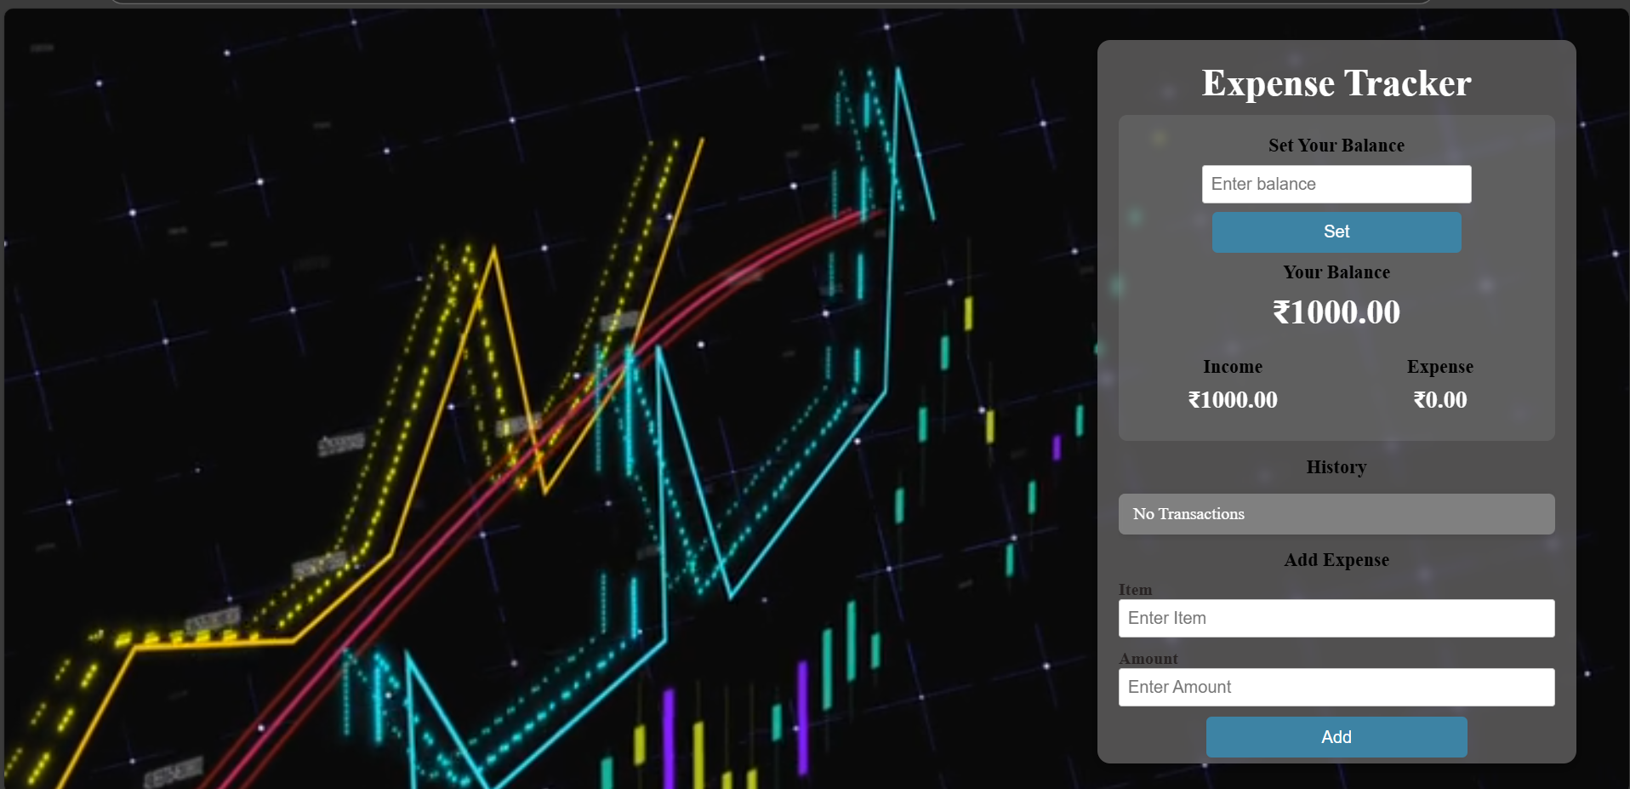




Slide 8
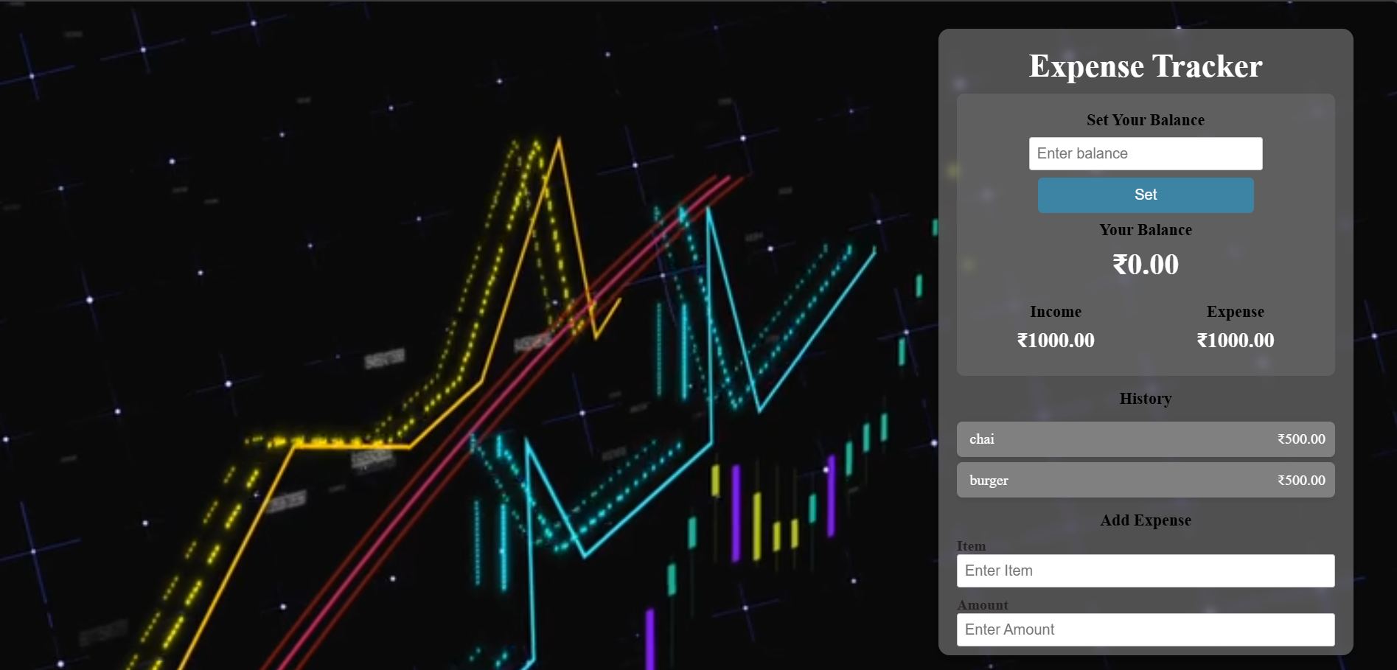



Slide 9
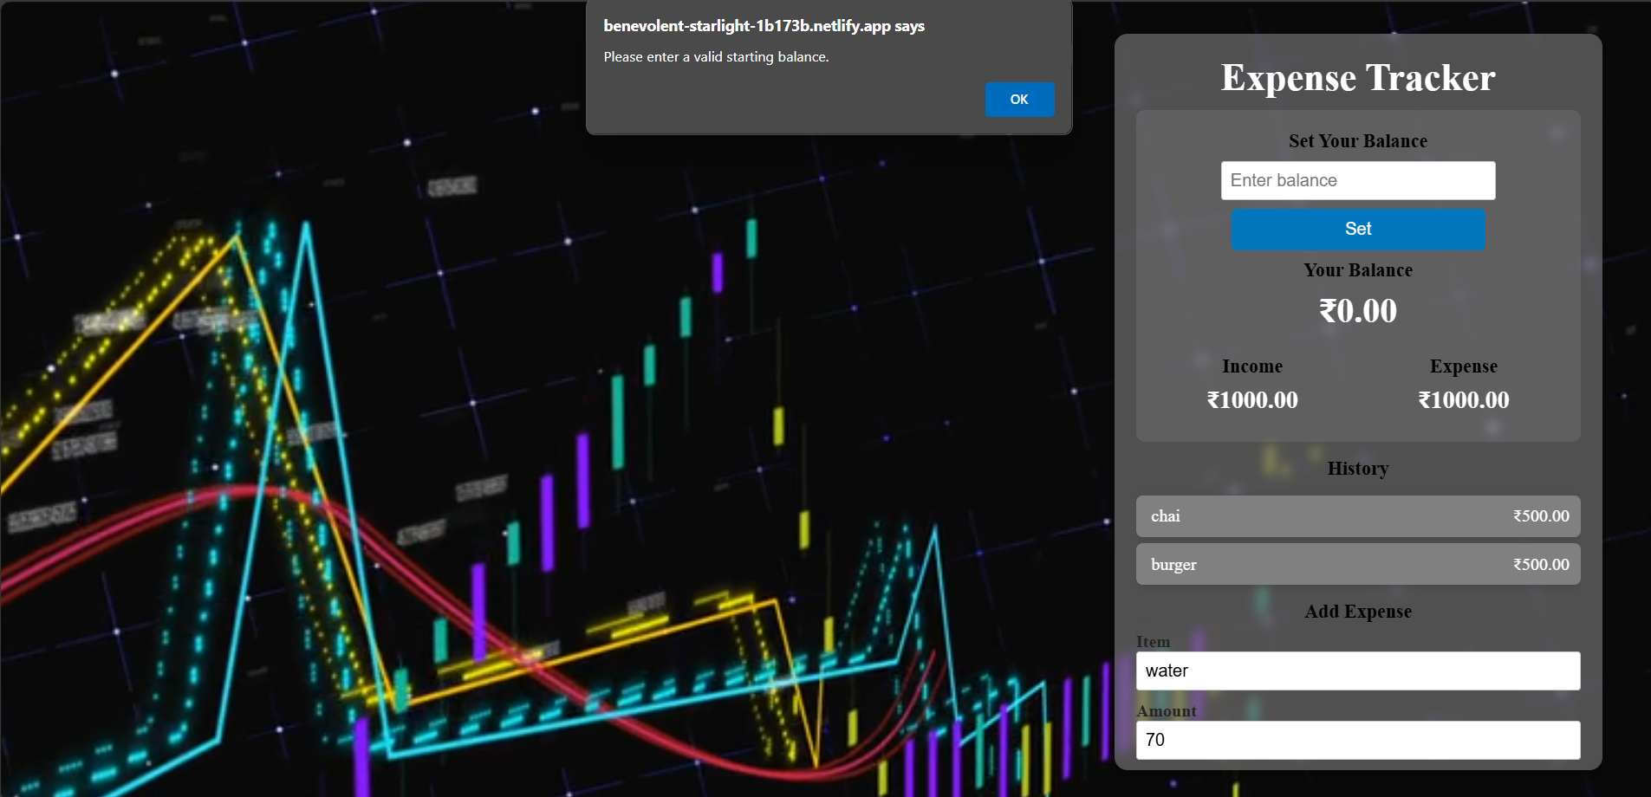



Slide 10
Technologies Used
HTML
CSS
JavaScript

Slide 11
Conclusion
Helps users efficiently track expenses
Provides a simple yet effective financial management tool
Can be expanded with additional features like data storage and reports

